Slide 1
Confidence Intervals
Confidence intervals for the population mean, μ
  when population standard deviation σ is known
  when population standard deviation σ is unknown
Determining the required sample size for a given level of confidence
1

Slide 2
Point and Interval Estimates
A point estimate is the value of a single sample statistic.
A confidence interval provides a range of values constructed around the point estimate.
Lower
Confidence
Limit
Upper
Confidence
Limit
Point Estimate
Width of confidence interval

Slide 3
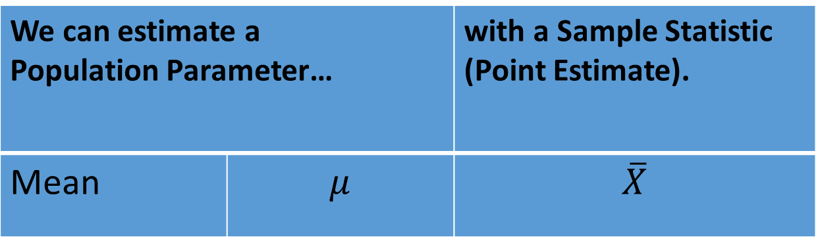

Point Estimate of the Population Mean $μ$
We can estimate a Population Parameter… |  | with a Sample Statistic (Point Estimate).
Mean | $$μ$$ | $$\overline{X}$$

Slide 4

Estimation Process
Random Sample
I am 95% confident that μ is between 40 & 60.
Mean
= 50
Population
(mean, μ, is unknown)
Sample

Slide 5
Confidence Interval
The general formula for all confidence intervals is:
Point Estimate ± (Critical Value)*(Standard Error)
Represents the level of confidence that the interval will contain the
unknown population parameter.
Common confidence levels = 90%, 95% or 99%:
Also written (1 - α) = 0.90, 0.95 or 0.99
Interpretation: In the long run, 90%, 95% or 99% of all the confidence intervals that can be constructed (in repeated samples) will contain the unknown true parameter.
NOTE: A specific interval will either contain or will not contain the unknown true parameter.

Slide 6


Confidence Interval of the Population Mean $μ$
Confidence Interval of the
Population Mean $μ$
σ Known
σ Unknown

Slide 7
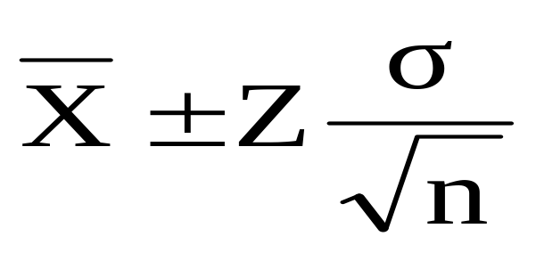


Confidence Interval for μ (σ Known)
Assumptions:
Population standard deviation σ is known
Population is normally distributed or if not then Central Limit Theorem applies
Confidence interval estimate
Where is the point estimate
Z is the normal distribution critical value for a probability of α/2 in each tail
is the standard error

Slide 8

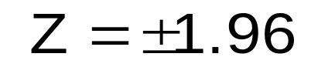
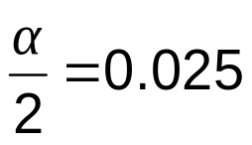
Finding the Critical Z Value
Consider a 95% confidence interval
Z units:
Z= -1.96
0
Z= 1.96
X units:
Lower
Confidence
Limit
Upper
Confidence
Limit
Point Estimate
Point Estimate

Slide 9

Common Levels of Confidence
90%, 95% and 99%
Confidence Coefficient
Confidence Level
Z value
80%
90%
95%
98%
99%
99.8%
99.9%
0.80
0.90
0.95
0.98
0.99
0.998
0.999
1.28
1.645
1.96
2.33
2.576
3.08
3.27

Slide 10





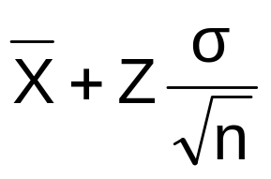



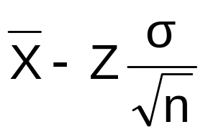

Intervals and Level of Confidence
Sampling Distribution of the Mean
x
Intervals extend from
to
(1-α)x100%
of intervals constructed contain μ;
(α)x100%
do not
Confidence Intervals

Slide 11
Confidence Interval Example
Imagine we have one sample of 11 pizza shops drawn from a large normally distributed population of pizza shops. Using our sample we find that the mean pizza cooking time is 2.20 minutes. We know from past testing that the population standard deviation is 0.35 minutes.
Determine a 95% confidence interval for the true mean pizza cooking time of the population.

Slide 12
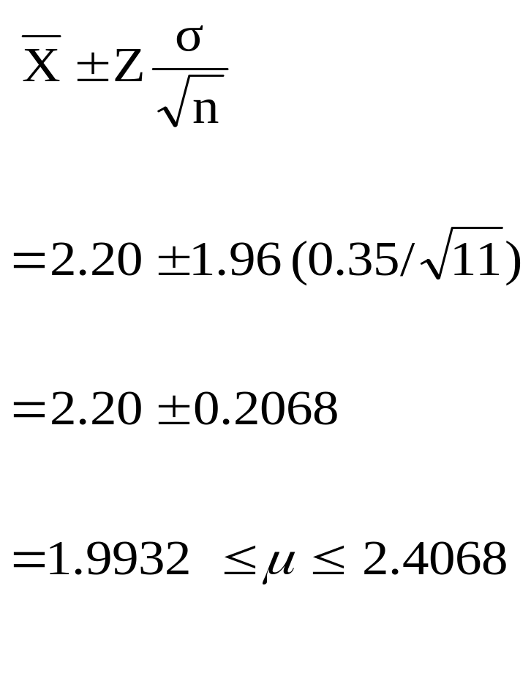
Confidence Interval Example
We are 95% confident that the true mean cooking time is between 1.9932 and 2.4068 minutes.
Although the true mean may or may not be in this interval, 95% of intervals formed in this manner (in repeated samples) will contain the true mean.

Slide 13

Confidence Interval of the Population Mean $μ$
Confidence Interval of the
Population Mean $μ$
σ Known
σ Unknown

Slide 14
Confidence Interval for μ (σ Unknown)
If the population standard deviation σ is unknown, we can substitute the sample standard deviation, S.
This introduces extra uncertainty, since S varies from sample to sample.
So we use the Student t distribution instead of the normal distribution:
The t value depends on degrees of freedom denoted by sample size minus 1 i.e. (d.f = n - 1).
Degree of freedom (d.f) are number of observations that are free to vary after sample mean has been calculated.

Slide 15
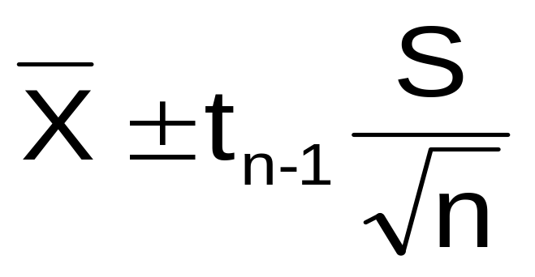
Confidence Interval for μ (σ Unknown) (continued)
Where t is the critical value of the t distribution with (n -1) degrees of freedom and an area of α/2 in each tail.

Slide 16
Degrees of Freedom
  Idea: Number of observations that are free to
  vary after sample mean has been calculated.
  Suppose the mean of 3 numbers is 8.0
    Let X₁ = 7
    Let X₂ = 8
    What is X₃?
If the mean of these three values is 8.0,
then X₃ must be 9
(i.e. X₃ is not free to vary)
Here, n = 3, so degrees of freedom = n – 1 = 3 – 1 = 2
(Two values can be any numbers, but the third is not free to vary for a given mean.)

Slide 17
Student’s t Table
Upper Tail Area
Let: n = 3
d.f = n - 1 = 2
α = 0.10
α/2 = 0.05
d.f
.25
.10
.05
1
1.000
3.078
6.314
2
0.817
1.886
2.920
α/2 = 0.05
3
0.765
1.638
2.353
The body of the table contains t values, not probabilities.
0
2.920
t

Slide 18
Confidence Interval Example
Note we are now assuming we do not know µ or σ
A random sample of 25 business women has a mean age of 50 and standard deviation of 8. These both refer to sample statistics not population parameters.
Form a 95% confidence interval for μ.

Slide 19
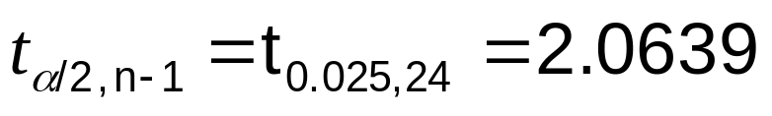
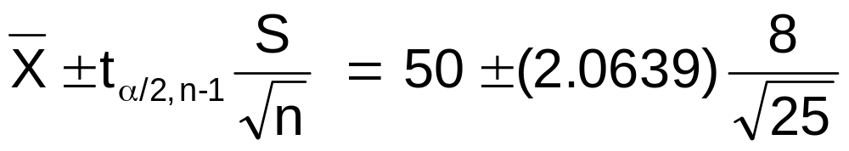
Confidence Interval Example (continued)
Degrees of Freedom are 25-1 = 24
46.698 ≤ μ ≤ 53.302

Slide 20
Determining Sample Size for the Mean
The required sample size can be found to reach a desired margin of error (e) with a specified level of confidence (1 - α).
Sampling error:
The margin of error is also called a sampling error:
The amount of imprecision in the estimate of the population parameter.
The amount added and subtracted to the point estimate to form the confidence interval.

Slide 21
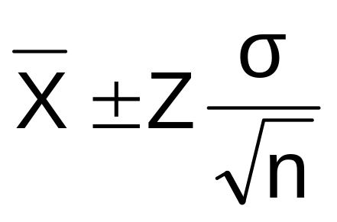
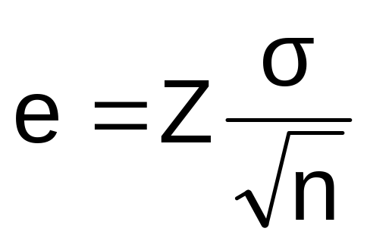
Determining Sample Size for the Mean (continued)
Confidence interval formula for population mean
Sampling error (margin of error)
denoted e

Slide 22
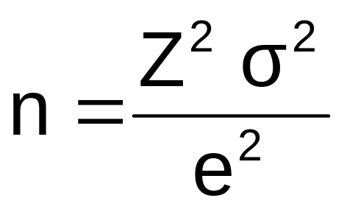
Determining Sample Size for the Mean (continued)
Now solve for n to get

Slide 23
Determining Sample Size for the Mean (continued)
To determine the required sample size for the mean,
you must know:
The desired level of confidence (1 - α), which
determines the critical Z value.
The acceptable sampling error, e.
The standard deviation, σ.

Slide 24
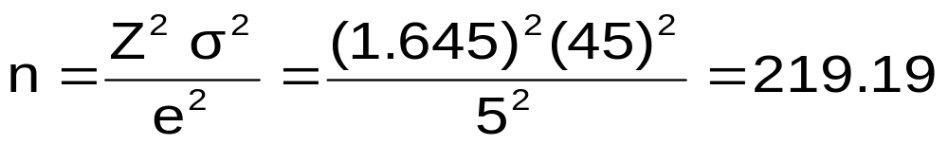
Determining Sample Size for the Mean (continued)
If σ = 45, what sample size is needed to estimate the mean within ± 5 with 90% confidence?
So the required sample size is n = 220
(Always round up.)

Slide 25
If σ is Unknown
If unknown, σ can be estimated:
  From past data using that data’s standard deviation.
  If population is normal, range is approx. 6σ so we can estimate σ by dividing the range by 6.
  Conduct a pilot study and estimate σ with the sample standard deviation, s.

